Slide 1

Movie Theater Management Database

Slide 2

Objectives
Our main objective for creating a movie theater management database for a theater business is to help provide the stakeholders key information that they could use to make business decisions. Using this data the company will have more detailed insights into its customers, movies and theater amenities. For instance, information about repeated and new customers can be obtained so that the company could run promotional campaigns. Additionally, geographical data about where customers live can help make decisions regarding business expansion and buying habits of these can be predicted too. For example, people living in affluent neighborhoods are more likely to purchase expensive tickets or visit the cinema more often, making it easier for the cinema to curate region-specific offers to increase revenue. Many such deeper insights can be gained through our database system.

Slide 3
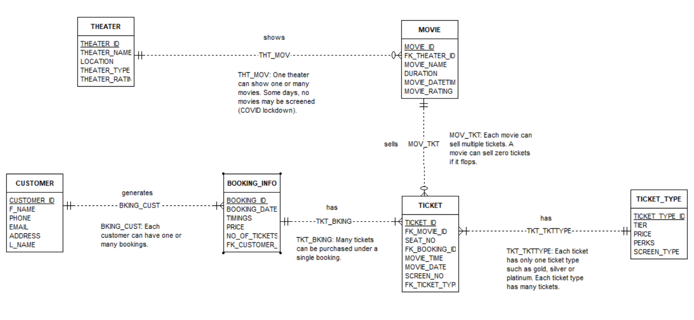
ERD
A THEATER may show zero or many MOVIES.
Each MOVIE is shown at one THEATER.
A MOVIE may sell zero or many TICKETS.
Each TICKET is associated with one MOVIE.
A TICKET has one TICKET TYPE.
Each TICKET TYPE has many TICKETS.
A BOOKING INFO may have one or many TICKETS associated with it.
Each TICKET is associated with one BOOKING INFO.
A CUSTOMER generates one or many BOOKINGS.
Each BOOKING INFO is generated by one CUSTOMER.

Slide 4
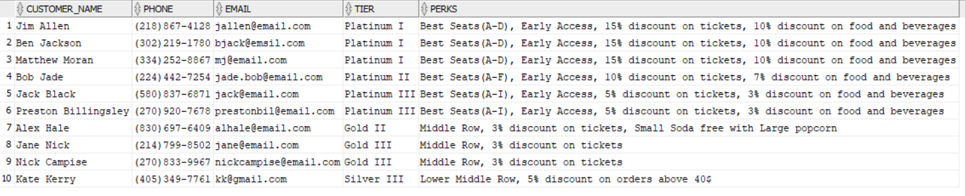
Advanced Queries
List name, email, phone of customers along with the tier and perks of the tickets they purchased to get insights about how much and how many customers are willing to spend on movie tickets.
select f_name || ' ' || l_name customer_name, phone, email, tt.tier, perks
from customer c
left join booking_info b
on c.customer_id=b.customer_id
left join ticket t
on b.booking_id = t.booking_id
left join ticket_type tt
on tt.ticket_type_id = t.ticket_type_id;

Slide 5
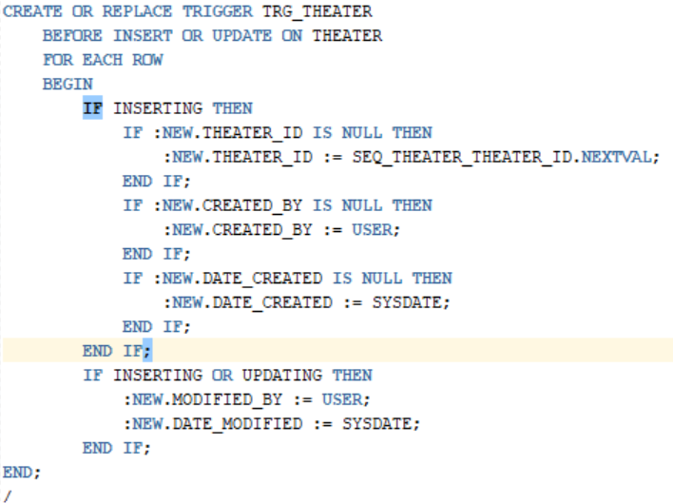
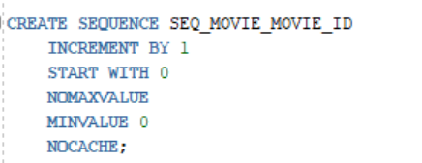
Triggers and sequence
A trigger is a named PL/SQL block stored in the Oracle Database and executed automatically when a triggering event takes place.
A sequence is a database object that allows the automatic generation of values, such as check numbers. Sequences are ideally suited to the task of generating unique key values especially primary keys.

Slide 6

Challenges
Deciding attribute distribution among related entities
While deciding entities between ticket and ticket type, we were skeptical whether we needed two separate entities or not, for ticket information, since we had more than 5 attributes that we wanted to incorporate. To overcome this challenge, we discussed the pros and cons as a group and made the decision of creation two different entities.

Slide 7

THANK YOU

